Slide 1

MSAI6124 Student Project – Stock Prediction Using Hybrid AI method
Jamwal Snigdha
G2304207H

Slide 2
Dataset
Trust Name: Keppel Real Estate Investment Trust (K71U.SI)
Duration: From 1st September 2009 to 31st January 2023
(The duration excludes the 2007 period as it’s an outlier due to the recession)
Training, Validation and Testing Split:
The ending 10% of the duration is taken as the testing dataset.
The rest of the dataset is split further split into 80 % training and 20% validation dataset.

Slide 3
FCM-LSTM
The hybrid model I followed combined a Fuzzy C-Means and Long Short-Term Memory to get the predicted stock prices.
Fuzzy C-Means (FCM)
Fuzzy C-Means (FCM) is a clustering algorithm widely utilized for its ability to handle data with inherent uncertainties. In contrast to traditional clustering methods, FCM assigns data points to multiple clusters simultaneously, reflecting the degree of membership rather than a binary classification. Developed as an extension of the classic K-Means algorithm, FCM introduces a fuzziness parameter that governs the degree of overlap between clusters. This characteristic makes FCM particularly suitable for applications where data points exhibit varying degrees of membership to different clusters, offering a more nuanced representation of complex patterns and relationships within the dataset.
Long Short-Term Memory (LSTM)
Long Short-Term Memory (LSTM) is a specialized recurrent neural network architecture designed to capture and model long-term dependencies in sequential data. Renowned for its ability to overcome the vanishing gradient problem, LSTMs excel in processing and memorizing information over extended time periods, making them particularly effective for tasks involving time series prediction

Slide 4
FCM-LSTM cont’d
To compare the effect of preprocessing on the model. The model was trained on:
1. Original Data with no pre-processing
2. Normalized Data
3. Stationary Data
The steps to create the FCM LSTM model used for predicting the stock prices are:
1. Define the required hyperparameters:
For the FCM:-
Error rate: 0.001
Maximum iteration : 1000
Fuzziness Co-efficient : 7
Number of clusters: The model iterated over having the number of clusters be from 2 to 9.

Slide 5
FCM LSTM – cont’d
For the LSTM :-
Sequence Length: 25 days
Epochs: 50
Batch Size: 20
2. Run the FCM for the Closing Price
3. Get the Cluster membership values
4. Create the sequence data with the close price and cluster membership values
5. Train the LSTM on the sequence data
6. Choose the number of clusters based on the RMSE of the validation dataset
7. Run the model with the least RMSE on the test data. In case any preprocessing was done to the input convert the predicted stock in the original scale.

Slide 6
Literature Review
Limited research has explored the amalgamation of Long Short-Term Memory (LSTM) networks with Fuzzy C-Means (FCM) in the context of stock forecasting and time series prediction. Noteworthy contributions include the application of a modified FCM-LSTM variant for asset price prediction in the stock market, as evidenced in [2]. Furthermore, variations of FCM-LSTM have been instrumental in short-term load forecasting, as highlighted in [4].
The comparative evaluations presented in [1] and [3] offer insights into the performance distinctions among different FCM-LSTM models. Particularly, [3] scrutinizes the comparative efficacy of various Fuzzy Time Series models against FCM-LSTM, emphasizing its relevance in stock market prediction scenarios. [1] introduces a distinctive perspective by utilizing a version of FCM-LSTM and demonstrating its effectiveness across diverse applications, including stock market prediction using closing prices and volume as inputs, and the prediction of base station traffic data.
Collectively, these studies underscore the emergent interest in FCM-LSTM hybrids, emphasizing their potential to address the complexities inherent in financial markets and time series data. While the research landscape is evolving, these contributions mark significant steps toward unraveling the capabilities of FCM-LSTM in tackling the dynamic and uncertain nature of financial markets and time-dependent datasets.

Slide 7
Benchmarking - LSTM
For benchmarking the performance of the FCM-LSTM model, a simple LSTM model with 1 hidden layer was used. I chose LSTM for benchmarking because LSTMs are a type of RNN that remember information over long periods of time. This makes them perfect for time series prediction and they frequently used for stock price prediction. Like the FCM-LSTM model, the LSTM model was also trained on the original, normalized and stationary stock closing prices.
The hyperparameters used to train the LSTM are:
1. epochs = 50
2. Batch Size = 100
3. Validation Split = 0.2
For the rest of the hyper-parameters the default values were used

Slide 8
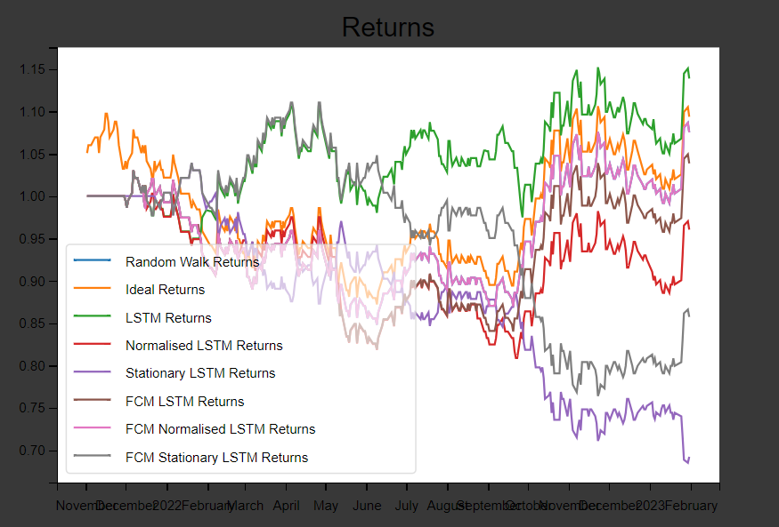
Analysis of Results
Model | Returns Earned
Random Walk | 1.075406
Ideal Case | 1.093697
LSTM | 1.138799
Normal LSTM | 0.960412
Stationary LSTM | 0.692142
FCM-LSTM | 1.03864
Normal FCM-LSTM | 1.075406
Stationary FCM-LSTM | 0.857299
Model | RMSE
Random Walk | 0.014906
Ideal Case | 0
LSTM | 0.024835
Normal LSTM | 0.020557
Stationary LSTM | 0.131780
FCM-LSTM | 0.014873
Normal FCM-LSTM | 0.015594
Stationary FCM-LSTM | 91.599200

Slide 9
Future Research
The stock market, known for its pronounced volatility and susceptibility to global events, demands an expanded approach in modeling. The current FCM-LSTM model, relying solely on past stock prices for predictions, prompts the need for future research to enrich its features. Specifically, attention should be directed toward incorporating additional dimensions like social media data and macro-economic indicators. Social media sentiments, especially from platforms like Twitter, could provide valuable insights into public sentiment and its potential influence on stock prices. Furthermore, integrating macro-economic indicators such as GDP growth, inflation rates, and geopolitical developments could offer a broader economic context for more accurate stock price predictions. Real-time news feeds, analyses of financial news, and consideration of major global events are also avenues for exploration. By extending the model's scope to encompass these diverse factors, researchers can enhance its performance and better capture the intricate dynamics of the stock market, ultimately improving its predictive capabilities in the face of the market's inherent complexity and susceptibility to external influences.

Slide 10
Bibliography
[1] H. Qu, J. Li and Y. Zhang, "Long Short-term Memory Network Prediction Model Based on Fuzzy Time Series," 2020 IEEE International Conference on Artificial Intelligence and Information Systems (ICAIIS), Dalian, China, 2020, pp. 417-421, doi: 10.1109/ICAIIS49377.2020.9194902.
[2] Siek, M. K. (2022). Fuzzy C-means long short-term memory (FCMLSTM) with application in exchange-traded funds (ETFs). Final Year Project (FYP), Nanyang Technological University, Singapore.
[3] Pattanayak, Radha Mohan, et al. “Fuzzy Time Series Forecasting Approach Using LSTM Model.” Computación Y Sistemas, vol. 26, no. 1, Mar. 2022, https://doi.org/10.13053/cys-26-1-4192.
[4] Fu Liu, Tian Dong, Qiaoliang Liu, Yun Liu, Shoutao Li, Combining fuzzy clustering and improved long short-term memory neural networks for short-term load forecasting, Electric Power Systems Research, Volume 226, 2024, 109967, ISSN 0378-7796, https://doi.org/10.1016/j.epsr.2023.109967.

